Slide 1
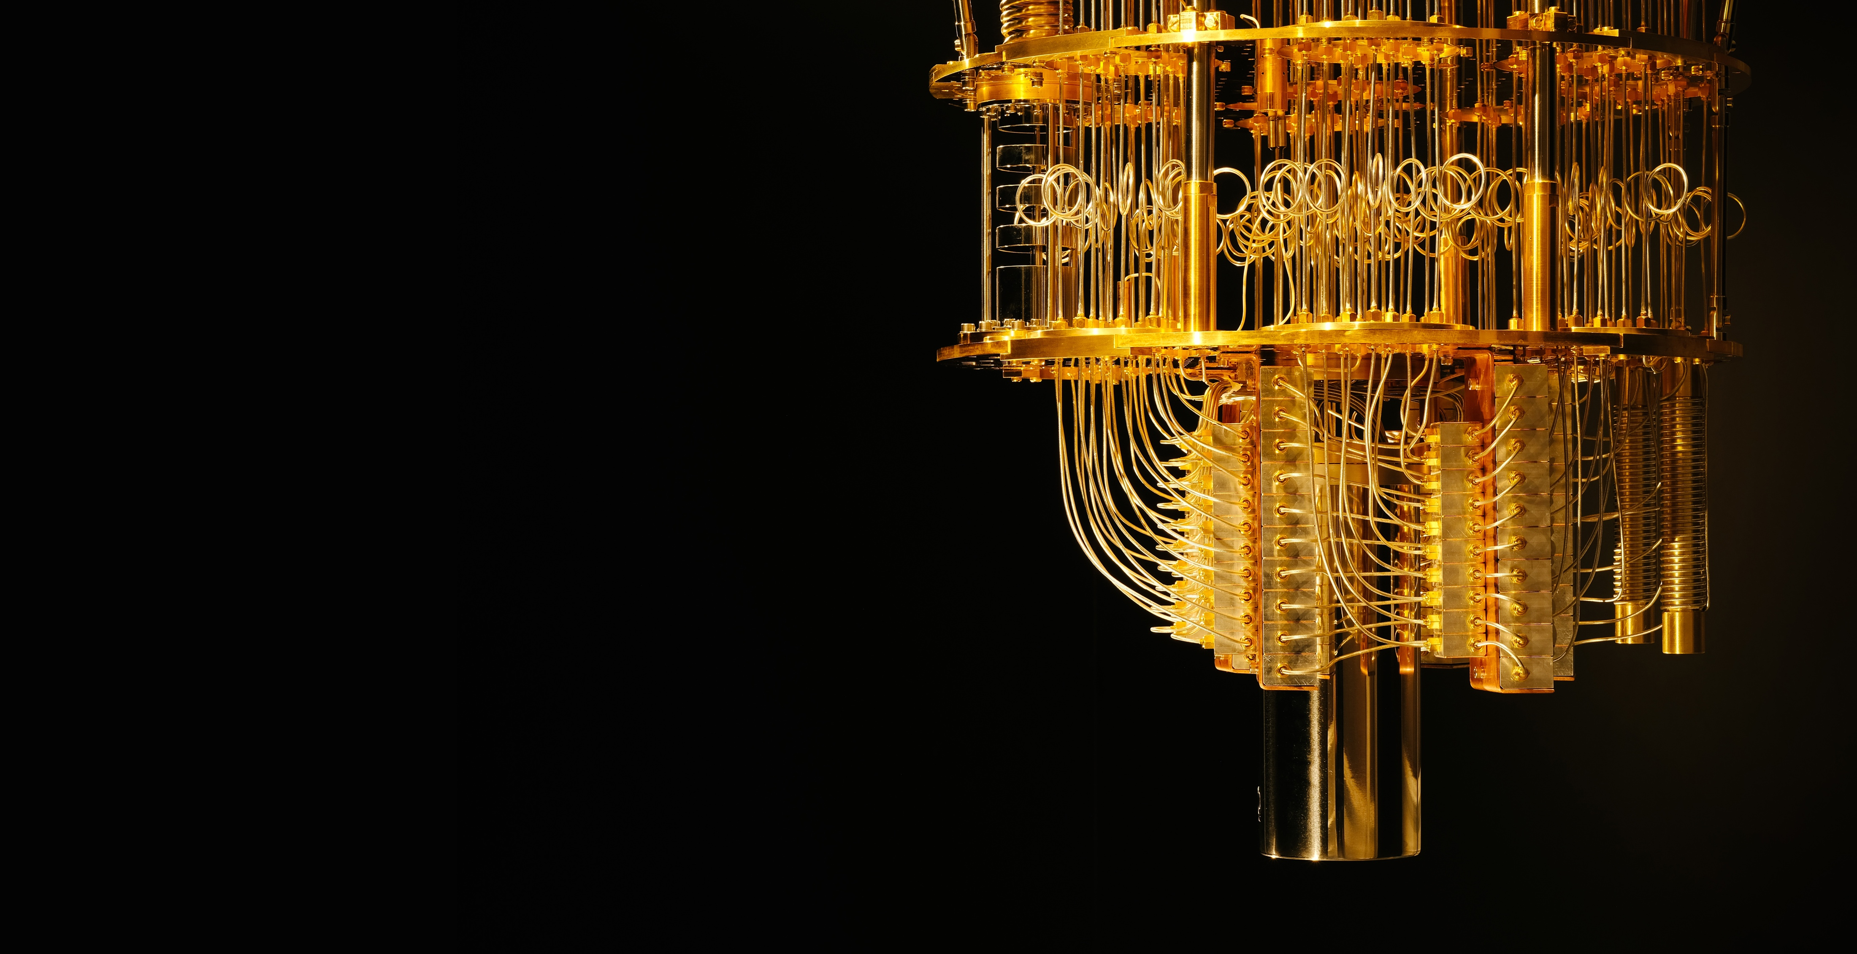
Variational Quantum Eigensolver
Fermionic Hamiltonian Encodings
Charles Hadfield
Applications Researcher,
数学者
IBM TJ Watson Research Center
Notes:
A denser version of this presentation can be found in the form of notes on fermionic encodings at math.berkeley.edu/~hadfield/research

Slide 2
Outline
1. Definition of fermionic encoding
Simulation of Nature’s hamiltonian using qubits
2. Basic encodings
Jordan-Wigner, Parity, Binary tree
3. More sophisticated encodings
Superfast, Generalised superfast
4. Tapering
Sparse LDPC, Reductions of qubits via symmetries

Slide 3
Outline (references)
1. Definition of fermionic encoding
2014 Bravyi, Hastings
2. Basic encodings
1928 Jordan, Wigner
2000 Bravyi, Kitaev
2012 Seeley, Richard, Love
3. More sophisticated encodings
2000 Bravyi, Kitaev
2018 Setia, Bravyi, Mezzacapo, Whitfield
4. Tapering
2017 Bravyi, Gambetta, Mezzacapo, Temme
Notes:
The structural definition via representations is standard. One reference could be:
- 2014 Bravyi, Hastings - arXiv:1410.0703v1
Jordan-Wigner
- 1928 Jordan, Wigner - DOI 10.1007/BF01331938
Parity
- 2012 Seeley, Richard, Love - arXiv:1208.5986v1
Binary tree
- 2000 Bravyi, Kitaev - arXiv:0003137v2
Superfast encoding
- 2000 Bravyi, Kitaev - arXiv:0003137v2
Generalised superfast
- 2018 Setia, Bravyi, Mezzacapo, Whitfield - arXiv:1810.05274v2
Tapering
- 2017 Bravyi, Gambetta, Mezzacapo, Temme - arXiv:1701.08213v1

Slide 4



Hubbard Model
Consider a graph with spin ½ fermions on vertices
$$G=(V,E)$$
$$H_{Hubbard}=−t\sum_{(i,j)∈E}{\sum_{σ∈\left\{↑,↓\right\}}{\left(a_{i,σ}^{†}a_{j,σ}+a_{j,σ}^{†}a_{i,σ}\right)}}+u\sum_{i∈V}{n_{i,↑}n_{i,↓}}$$
t ~ hopping of arbitrary spin from one site to same spin at neighbouring site
u ~ potential for finding two electrons at same site
~ number operator
$$n_{i}=a_{i}^{†}a_{i}$$
Notes:
1963 Hubbard - DOI 10.1098/rspa.1963.0204

Slide 5

Fermionic Hamiltonians
We’ll study a system with M local fermionic modes
$$H_{Nature} = \sum_{i,j}{t_{ij} a_{i}^{†}a_{j}}+\sum_{i,j,k,l}{u_{ijkl}a_{i}^{†}a_{j}^{†}a_{k}a_{l}}$$
used to study: hopping, chemical potential, two particle interactions
not used to study: superconductivity, relativistic effects
Notes:
1963 Hubbard - DOI 10.1098/rspa.1963.0204

Slide 6



Fermionic Hamiltonians
$$H_{Nature}=\sum_{i,j}{t_{ij} a_{i}^{†}a_{j}}+\sum_{i,j,k,l}{u_{ijkl}a_{i}^{†}a_{j}^{†}a_{k}a_{l}}$$
$H_{Nature} : ℋ_{Nature} ⟶$ $ℋ_{Nature}$
$$\left|\left.n_{1},n_{2},…,n_{M}\right\rangle \right.$$
M fermionic modes present
Hamiltonian acts on the Hilbert space of dimension 2^{M}

Slide 7



Representation on a quantum computer
$$ℋ_{simulator}= {\left(ℂ^{2}\right)}^{⊗Q}$$
QC with Q qubits gives us access to Hilbert space:
Our goal is to build an isometry:
And construct a simulator Hamiltonian of Nature’s Hamiltonian such that:
$ℰ : ℋ_{Nature} ⟶ ℋ_{simulator}$
$$H_{simulator} ∘ ℰ = ℰ ∘ H_{Nature}$$

Slide 8
Representation on a quantum computer
$$ℋ_{simulator}= {\left(ℂ^{2}\right)}^{⊗Q}$$
QC with Q qubits gives us access to Hilbert space:
Our goal is to build an isometry:
And construct a simulator Hamiltonian of Nature’s Hamiltonian such that:
$ℰ : ℋ_{Nature} ⟶ ℋ_{simulator}$

Slide 9
Representation on a quantum computer
$$ℋ_{simulator}= {\left(ℂ^{2}\right)}^{⊗Q}$$
QC with Q qubits gives us access to Hilbert space:
Our goal is to build an isometry:
And construct a simulator Hamiltonian of Nature’s Hamiltonian such that:
$ℰ : ℋ_{Nature} ⟶ ℋ_{simulator}$
$$H_{simulator} ∘ ℰ = ℰ ∘ H_{Nature}$$
sometimes useful to have larger simulator space
focus on understanding the simulator Hamiltonian (rather than the encoding)

Slide 10
Basic encodings

Slide 11












Jordan-Wigner transformation
$$n_{1},n_{2}$$
$$\left|\left.n_{1},n_{2}\right\rangle \right.$$
Let’s do an example of two modes with a very simple encoding
$$\left|\left.00\right\rangle \right.$$
$$\left|\left.10\right\rangle \right.$$
$$\left|\left.01\right\rangle \right.$$
$$\left|\left.11\right\rangle \right.$$
Let’s also do the naive encoding of the creation and annihilation operators
$$a_{i}={\left|\left.0\right\rangle \right.\left\langle \left.1\right|\right.}_{i}$$
$$a_{i}^{†}={\left|\left.1\right\rangle \right.\left\langle \left.0\right|\right.}_{i}$$
And now let’s see what happens...
$$a_{1}^{†}a_{2}\left|\left.01\right\rangle \right.=\left|\left.10\right\rangle \right.$$
$$a_{2}a_{1}^{†}\left|\left.01\right\rangle \right.=\left|\left.10\right\rangle \right.$$
$$a_{1}^{†}a_{2}+a_{2}a_{1}^{†}≠0$$
☹️
What we really need:
$$a_{i}\left|\left.…,1,…\right\rangle \right.={(−1)}^{∑}\left|\left.…,0,… \right\rangle \right.$$
Notes:
The Jordan-Wigner transformation is given in an identical form by Brauer and Weyl in 1935 doi:10.2307/2371218

Slide 12





Jordan-Wigner transformation
$$n_{1},n_{2}$$
$$\left|\left.n_{1},n_{2}\right\rangle \right.$$
Let’s do an example of two modes with a very simple encoding
$$\left|\left.00\right\rangle \right.$$
$$\left|\left.10\right\rangle \right.$$
$$\left|\left.01\right\rangle \right.$$
$$\left|\left.11\right\rangle \right.$$
Let’s do a more sophisticated so that morally:
$$a_{i}={\left|\left.0\right\rangle \right.\left\langle \left.1\right|\right.}_{i}$$
$$a_{i}\left|\left.…,1,…\right\rangle \right.={(−1)}^{∑}\left|\left.…,0,… \right\rangle \right.$$
Now the calculation will go through as
$$a_{1}^{†}a_{2}\left|\left.01\right\rangle \right.=\left|\left.10\right\rangle \right.$$
$$a_{2}a_{1}^{†}\left|\left.01\right\rangle \right.=a_{2}\left|\left.11\right\rangle \right.$$
$=−\left|\left.10\right\rangle \right.$
$$a_{1}^{†}a_{2}+a_{2}a_{1}^{†}=0$$
🙂️
The appearance of
$$\left|\left.0\right\rangle \right.\left\langle \left.1\right|\right.$$
can be replaced by a sum of Paulis
$$½(X−iY)$$
Notes:
The Jordan-Wigner transformation is given in an identical form by Brauer and Weyl in 1935 doi:10.2307/2371218

Slide 13


Jordan-Wigner transformation
Modes get mapped directly onto quantum computer
Creation/annihilation operators need to keep track of parity
$$a_{i}\left|\left.…,1,…\right\rangle \right.={(−1)}^{∑}\left|\left.…,0,… \right\rangle \right.$$
$${\left(a_{i}\right)}_{Nature} ⟼{\left(a_{i}\right)}_{JW}=Z_{1}Z_{2}⋯Z_{i−1}{\left|\left.0\right\rangle \right.\left\langle \left.1\right|\right.}_{i}$$
The appearance of
$$\left|\left.0\right\rangle \right.\left\langle \left.1\right|\right.$$
can be replaced by a sum of Paulis
$$½(X−iY)$$

Slide 14
Jordan-Wigner transformation
Modes get mapped directly onto quantum computer
Creation/annihilation operators need to keep track of parity
occupation of modes is stored locally in simulator Hilbert space
parity of system is stored non-locally in simulator Hilbert space
tracking the parity leads to encodings of operators with weight
caveats: Hubbard model 1D, 2D
caveats: we’re interested not really in but rather even products

Slide 15
Parity transformation
Parity encoding sends to where
some examples:
The best way to understand this transformation is to calculate the map
and then deduce the structure of Hamiltonian terms via
but here’s the answer ...

Slide 16
Parity transformation
Parity encoding sends to where
The annihilation (and creation) operators get sent to
The operators
check the previous parity
adjust the current parity
update future parities
The bra/ket notation can be turned into Paulis using

Slide 17
Parity transformation
Parity encoding sends to where
The annihilation (and creation) operators get sent to
The operators
check previous and adjust current parities with weight
update future parities with weight
Like with the Jordan-Wigner situation, we are still left with terms of weight

Slide 18
Binary tree transformation
Bravyi and Kitaev’s idea is to find a middle ground
occupation of mode
parity of system
The idea comes from classical computer science
how do you encode a table of numbers when you want ability to update elements and compute check sums?
answer: Fenwick trees
What do we gain?
Encoding of operators such that weight

Slide 19
Binary tree transformation
Let’s do the simplest interesting example of four modes (4=2²) and consider
Binary tree for 4 provides a partial order on n₁ , n₂ , n₃ , n₄ :
11
n₄
10
01
n₃
n₂
00
n₁
x₄= n₄ +x₂+ x₃
x₃=n₃
x₂=n₂+x₁
One example:
x₁=n₁

Slide 20
Binary tree transformation
11
n₄
10
01
n₃
n₂
00
n₁
In order to write down encodings of operators, we need to keep track of several families
Parity family (like the Z’s occurring in Jordan-Wigner, effectively what is below n_{i} in the Binary tree)
Update family (like the X’s occuring in Parity, effectively what is above n_{i} in the Binary tree)
Flip family (like the pre-check occuring in Parity)

Slide 21
Superfast encodings

Slide 22
Superfast encoding
Bravyi and Kitaev’s encoding contains two new ideas we haven’t employed
Encode only some operators
we don’t need to understand the appearance of individual
our Hamiltonians only involve even products of these operators
“parity preserving”
Use more qubits
the simulator Hilbert space will be much larger than Nature’s Hilbert space
we will therefore need a way to find the right subspace inside our simulator
The story involves Majorana fermions, and ideas of stabiliser codes from quantum error correction

Slide 23
Superfast encoding (notational preparation)
All possible Hamiltonians are all built from the algebra generated by
But there are other generating sets:
Hamiltonians actually belong to a smaller space that preserves parity
And the Majoranas offer a neat way of writing down a generating set:
Attention: I’m indexing from 1, not 0
Notes:
An illustration of how to define the weight 4 terms which appear in quantum chemistry Hamilonians is given in Section IV of Setia-Whitfield https://arxiv.org/abs/1712.00446
Comment on the symmetries that these operators satisfy

Slide 24
Superfast encoding (warm up example)
Consider a Hamiltonian with two vertices which displays a hopping phenomenon
and even easier: consider only spin up electrons
Attention: I’m indexing from 1, not 0
Notes:
An illustration of how to define the weight 4 terms which appear in quantum chemistry Hamilonians is given in Section IV of Setia-Whitfield https://arxiv.org/abs/1712.00446
Comment on the symmetries that these operators satisfy

Slide 25
Superfast encoding
Consider a Hamiltonian with two vertices which displays a hopping phenomenon
and even easier: consider only spin up electrons
Some exercises for the dedicated reader:
consider a chain of spin up electrons
consider a chain with both spin up and spin down electrons at each vertex
push this example to a two-dimensional lattice
Attention: I’m indexing from 1, not 0
Notes:
An illustration of how to define the weight 4 terms which appear in quantum chemistry Hamilonians is given in Section IV of Setia-Whitfield https://arxiv.org/abs/1712.00446
Comment on the symmetries that these operators satisfy

Slide 26
Superfast encoding
Write the Hamiltonian
and now start drawing (hopefully low-weight) graphs:
Superfast encoding
associates qubits to edges
and sends
Notes:
An illustration of how to define the weight 4 terms which appear in quantum chemistry Hamiltonians is given in Section IV of Setia-Whitfield https://arxiv.org/abs/1712.00446

Slide 27
Superfast encoding
What has this done well?
Encoded operators have weight determined by the degree of the vertices
Our graphs will always have more edges than vertices
so the number of qubits will outnumber the number of modes
handling these extra degrees of freedom requires finding the right subspace
Notes:
An illustration of how to define the weight 4 terms which appear in quantum chemistry Hamilonians is given in Section IV of Setia-Whitfield https://arxiv.org/abs/1712.00446
Comment on the symmetries that these operators satisfy

Slide 28
Qubit tapering

Slide 29
Tapering of qubits
Maybe we can exploit symmetries of our Hamiltonian to reduce the cost of qubits?
Suppose we already have a Hamiltonian mapped onto two qubits
And now we realise that the Hamiltonian commutes with Z₁ then
and
Then have energy spectra so let’s go solve each smaller Hamiltonian on a smaller quantum computer
Qubit tapering offers a systematic way to find these symmetries

Slide 30
Tapering of qubits
We can exploit symmetries of our Hamiltonian to reduce the cost of qubits.
What are some of these symmetries?
conservation of number of electrons
conservation of spin (both numbers of spin up/down)
geometric symmetries of the molecule: reflections, rotations
Examples:
Hydrogen:
four spin orbitals simulated with four qubits using Jordan-Wigner or Binary tree
three symmetries: spin up, spin down, reflection
result: simulate with one qubit
Water
reflection symmetry of two hydrogen atoms

Slide 31
Tapering of qubits
But how does it work? It comes down to an efficient representation of Pauli terms in a “symplectic representation” and a neat theorem about stabiliser groups (of error correction), both of which are found in the PhD of Gottesman.
If and we can find a symmetry group
Then we can consider a conjugated Hamiltonian
And we can go and study the 2^{r} reduced Hamiltonians on QCs with fewer qubits.

Slide 32
Recapitulation
1. Definition of fermionic encoding
Simulation of Nature’s Hamiltonian using qubits
2. Basic encodings
Jordan-Wigner, Parity, Binary tree
3. More sophisticated encodings
Superfast, ideas from stabiliser codes of quantum error correction
4. Tapering
Reductions of qubits via symmetries

